Slide 1
“MEASURE OBJECT DIMENSION FROM IMAGES”
By – Anurag Kumar Sahu

Slide 2
TOPICS
Objective
Digital Image
Approach(Reference Object Method)
Implementation
Output
Observations

Slide 3
OBJECTIVE
To determine real dimension of objects in an image using openCV.

Slide 4
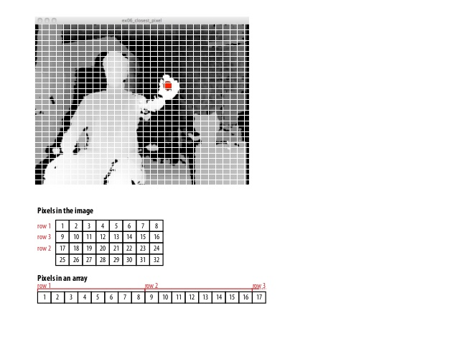
DIGITAL IMAGE
What is a Digital Image?
A digital image is a representation of two-dimensional image as a finite set of digital values, called picture elements or pixels.
Pixel values typically represents Gray
levels, colours, heights, Opacities etc.
There are different types of images &
their colour formats like binary images
where all pixel values are either 0 & 1.
0 &1refers to black & white colour resp.
Some other types of images are B&W
Images gray scale image(8bit colour
format), RGB format(16 bit colour
format).

Slide 5
APPROACH(Reference Object Method)
Input Image
Pass the source Image
Grayscale + Blurred Image
Convert the input image into Grayscale & blur it slightly to remove unwanted noise
Canny Edge detection + Erosion + Dilation
Perform canny edge detection and apply morphological operation(Erosion & dilation) in order to enhance canny edge algorithm
Here, we also get our edge map
Find Contours, Sort them and draw the contours
Draw necessary shapes on contours in order to find midpoints on contour edge
Find Pixel-Per-Cm variable, also find Euclidean distance b/w the midpoints on the contour edge
Draw distance B/W the midpoints with the help of pixel-per-cm variable
Draw the dimensions & get the Output Image
Calculate distance & show them in output Image

Slide 6
IMPLEMENTATION
Import the required Modules.
Pass & show the Input Image.
Pre-process the Image.
Find contours, sort contours, draw contours.
Find & Draw midpoints on the contour edge.
Draw line B/W midpoints & apply Euclidean function to calculate distance B/W the midpoints.
Draw object dimensions & Show the Output Image.

Slide 7
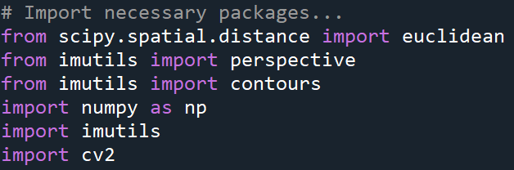
Import the required Modules
cv2 Module : This module is used to perform image processing related operations.
Imutils Module: It is a series of convenient functions to make basic image processing functions with openCV and python more easier. Provided you already have Numpy, Scipy, openCV already installed, the imutils package is completely pip installable.
Scipy Library: This library is used for scientific calculation in research areas. From this library we’ve imported Euclidean function from a submodule named distance.
Numpy Module: This module is used to perform high level operations on arrays.

Slide 8
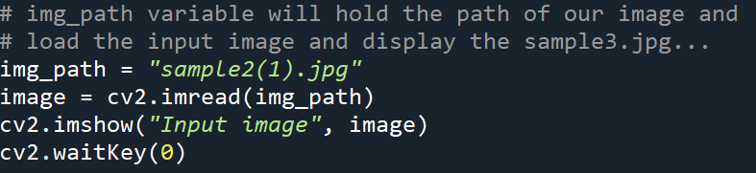
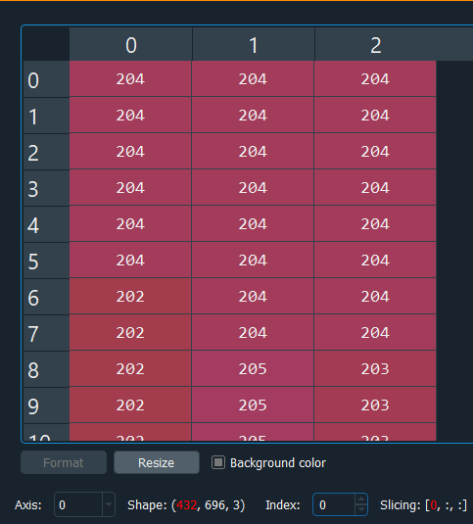
PASS THE SHOW INPUT IMAGE
Here, we’ve created a variable img_path which will hold our input image source and Passed that variable into cv2.imread() which will read the image and convert it into three-dimensional array of integers as shown in the figure.
Now, image variable will hold the array.
Pass image variable into cv2.imshow() to show the
input image with window name “Input Image”
Then, cv2.waitkey(0) waits for user input to release the
Window.

Slide 9
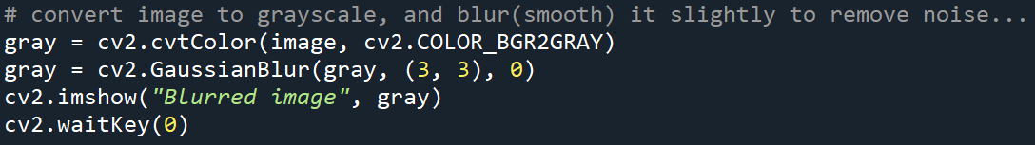
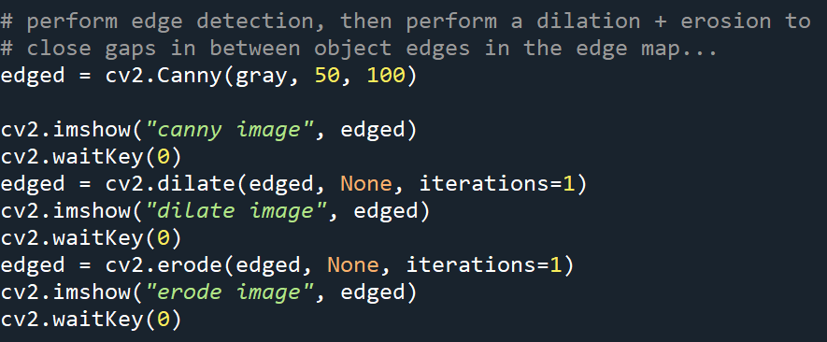
PRE-PROCESS THE IMAGE
Now, We’ve converted the image into grayscale and blur it slightly to remove the High frequency noise to make our contour detection process more accurate.
Here, we’ve passed the grayscale image into canny edge detector function to detect edges in our image, Erosion & Dilation these are the morphological operations to effectively detect the edges in the edge map.
The above process can be said as a Binarization of image.

Slide 10
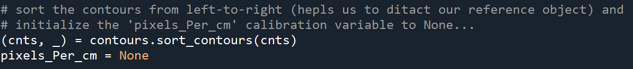
FIND CONTOURS, SORT CONTOURS, DRAW CONTOURS.
Here, we’ll find contours(i.e, outlines) of all the objects in our image starting from our referenced object. The contours returned by the cv2.findContours are unsorted and in a tuple format.
Imutils.grab_contour() grab the appropriate tuple value based on whether you’re using openCV2.4 , 3 , 4.
We’ll sort our tuple of contours from left-to-right. This will help us to find our referenced object.
Here, we’ll also initialize pixels_per_cm variable to None for further use.

Slide 11
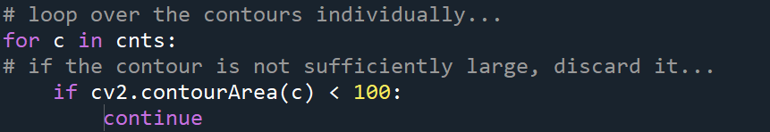
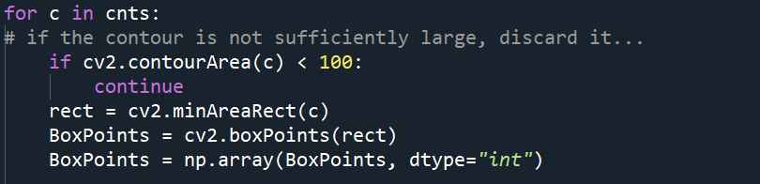
FIND CONTOURS, SORT CONTOURS, DRAW CONTOURS.
Here, we’ll iterate over the sorted contours individually and check the contour’s area is less than the 100 then continue to execute the below code of lines. Otherwise discard that region.
Here, cv2.minAreaRect() accepts individual contours on each iteration and it will return a 2D box structure with minimum area but to draw the box we’ll need it’s corner points. These corner points can be achieved by cv2.boxPoints() and we’ll covert boxpoints from float to int

Slide 12
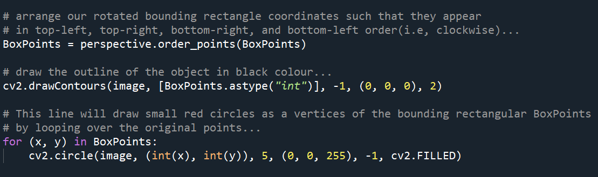
FIND CONTOURS, SORT CONTOURS, DRAW CONTOURS
Here, we’ll sort our boxpoints in clockwise direction with the help of perspective.order_points() in each iteration
Then, we’ll draw our contours(black colour) with the help cv2.drawContours in each iteration.
Then, we’ll iterate over the BoxPoints to draw small circles(red colour) as a vertices of our box in clockwise direction.

Slide 13
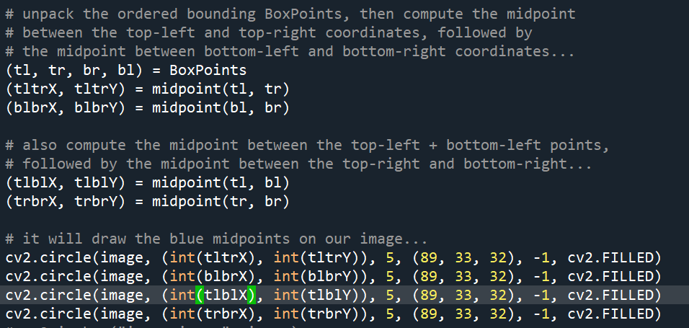
FIND & DRAW MIDPOINTS ON THE CONTOUR EDGE
From BoxPoints extract all the coordinates and store them into tl, tr, bl ,br variables.
Pass tl, tr into the midpoints function to get the coordinates of the midpoints on the contour edge.
Follow same procedure for bl, br & tl, bl & tr, br to get all respective coordinates of midpoint on the contour edge.
Apply cv2.cirlcle function to draw a circle(blue colour) on the each midpoint.

Slide 14
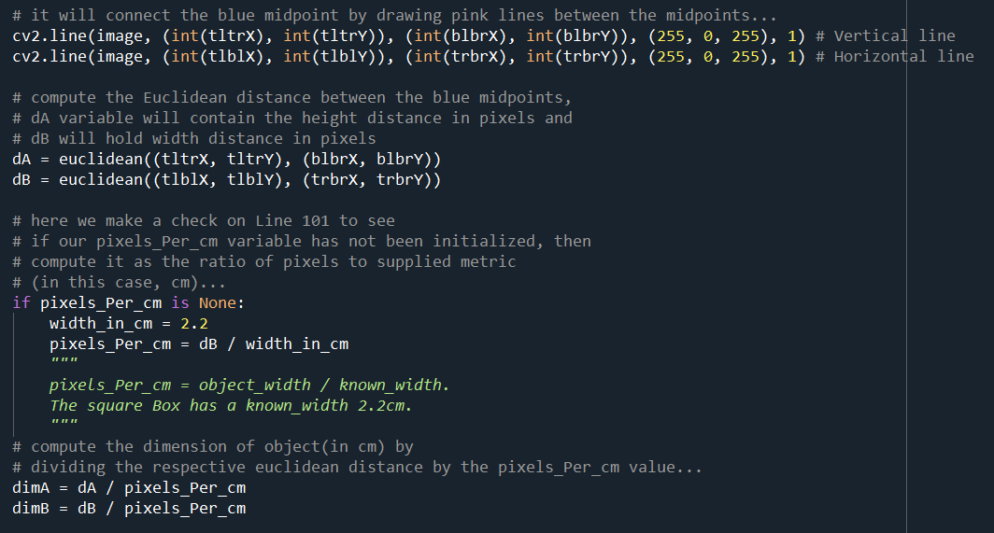
Draw line B/W midpoints & apply Euclidean function to calculate distance B/W the midpoints.
Here, with cv2.line() we’ll draw line(Pink colour) b/w blue midpoints .
Then, we’ll pass the coordinates of the midpoints into Euclidean function to determine length and width of the line(Pink colour) in pixels. We don’t want these height & width in pixels so, we’ll compute our pixels_per_cm variable to determine How many pixels are present in 2.2cm width on the basis of that we divide the height & width by the pixels_per_cm variable to get height & width in cm.

Slide 15
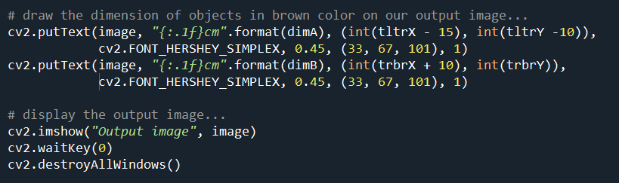
Draw object dimensions & Show the Output Image.
Here, we’ll draw the object dimension on the output image with the help of cv2.putText().
Then, Show the Output Image with window name “Output Image”.

Slide 16
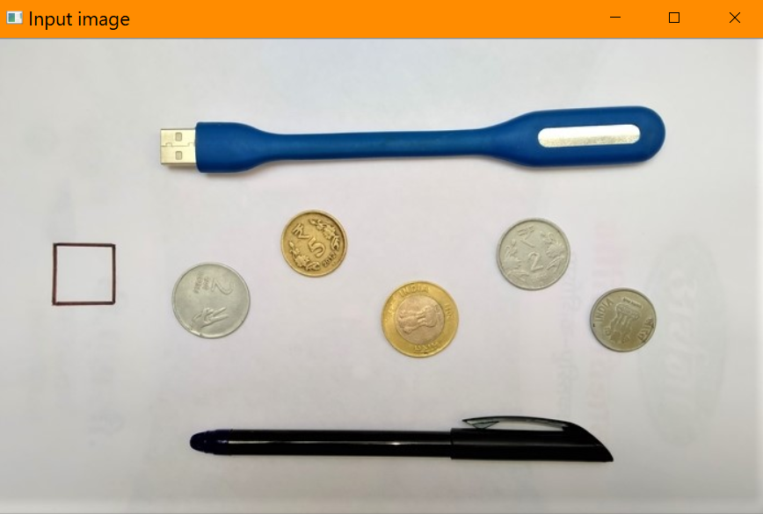
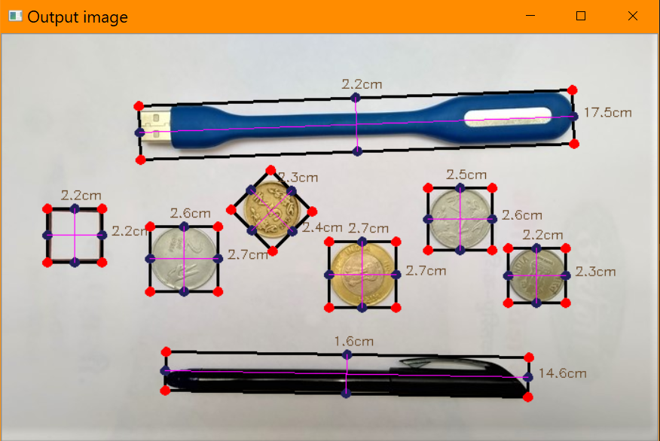
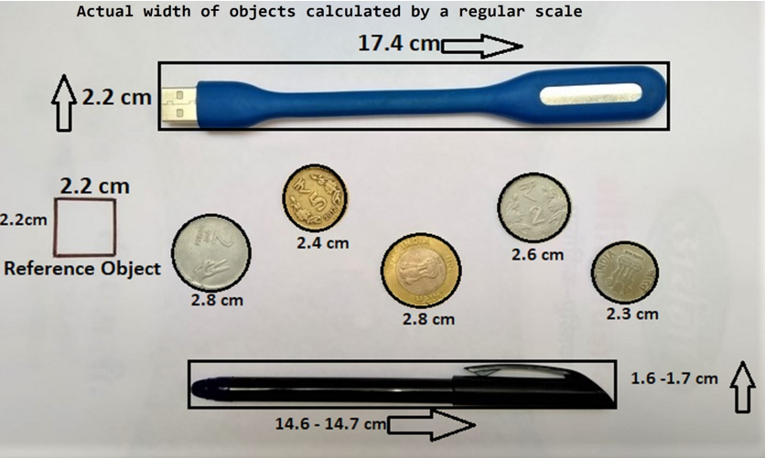
OUTPUT
INPUT IMAGE
ACTUAL MEASUREMENT
OUTPUT IMAGE

Slide 17
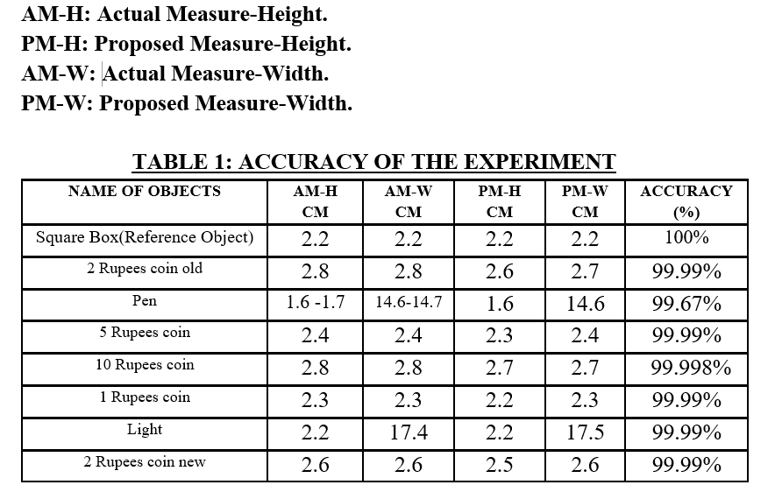
OBSERVATIONS

Slide 18
THANK YOU

